Slide 1
Ticket Analysis with Markov Chain
How a Markov Chain can be applied to analyzing service tickets and used for data production
11-14-2018
Don Bacon

Slide 2
In This Exciting Hour You Will Learn…
What is a Markov Chain
How Markov Chain structure can be applied to analyzing service tickets
How to use a Markov chain to analyze and produce all kinds of data
And more!

Slide 3

But First…
A story
Fun Fact: A good story is Authentic, is Creative, makes an Emotional and Personal connection, takes the Audience on a Journey.

Slide 4

I was curious
About brand drug names
Xarelto
Where do they come from?
Pradaxa
Any patterns to the names?
Xifaxan
Tremfya
Could I make software that could discover these patterns to create my own drug names?
Xeljanz
What else could I apply this to?

Slide 5


Which got me
about
What makes their music so special?
Any patterns to the chord progressions?
Could I make software that could discover these patterns to create my own “Beatles-esque” music?

Slide 6
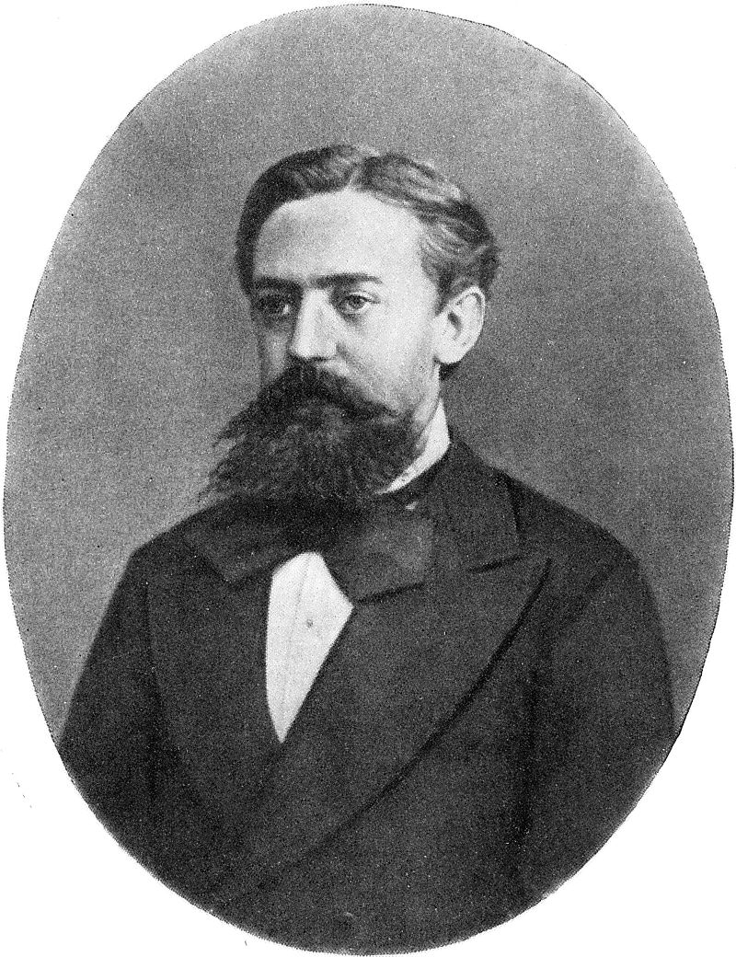
What do the problems around drug names, service tickets and The Beatles all have in common?
Markov Chain
Andrey Andreyevich Markov (1856 – 1922)

Slide 7
Applications
Text analysis

Slide 8
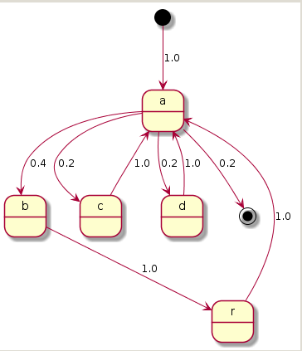
So What is a Markov Chain?
A structure describing a sequence of possible events in which the probability of each event depends only on the state attained in the previous event.
Simple text example: “abracadabra”
Not very interesting

Slide 9
Order 1 Markov Chain State Transition Diagram
Service Tickets (sample)
0.02857
import
0.15385
0.15385
0.06098
0.64634
0.02439
0.02439
tool
utility
spreadsheet
0.07143
0.11429
0.08571
product
map
add
0.15385
0.15385
configuration
0.04286
0.02857
adjustment
occurrence
enhancement
issue

Slide 10
Markov Chain with Memory
Number of remembered states is the Order of the Markov Chain.
To use the Import example (click the mouse!)

Slide 11
Order 2 Markov Chain State Transition Diagram
0.03774
5 other
22.64%
import tool
35.85%
0.01887
19 other
0.15094
0.11321
0.09434
0.0566
0.03774
configuration
map
add
issue
ui

Slide 12
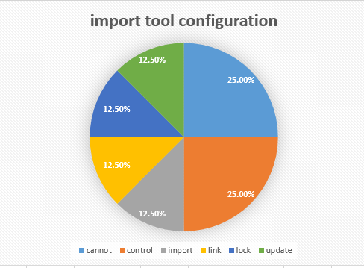
Markov Chain order 3 “import tool configuration”
{ "import tool configuration" :
{
"totalOccurrence" : 8,
"cannot": {
"occurrence" : 2, "probability" : 0.25
},
"control": {
"occurrence" : 2, "probability" : 0.25
},
"import": {
"occurrence" : 1, "probability" : 0.125
},
"link": {
"occurrence" : 1, "probability" : 0.125
},
"lock": {
"occurrence" : 1, "probability" : 0.125
},
"update": {
"occurrence" : 1, "probability" : 0.125
}
}
}

Slide 13
Collector – Producer Pattern
Collector – Creates an order-n Markov Chain from source Data
Producer – Creates data based on Markov chain probabilities
Raw Data
Collector
Markov chain
Producer
Simulated Data

Slide 14
Collector – Producer Examples
Collector | Markov Chain | Producer | Output
CharacterCollector | MarkovChain<Character, Word> | WordProducer | Set<Word>
WordCollector | MarkovChain<Word, Sentence> | SentenceProducer | Set<Sentence>
HarmonyChordCollector | MarkovChain<HarmonyChord, ChordProgression | ChordProgressionProducer | ChordProgressionScrapbook
Collect
From
To Produce
Characters
Sentence
Words
Words
Book
Sentences
HarmonyChords
Song
ChordProgressions

Slide 15
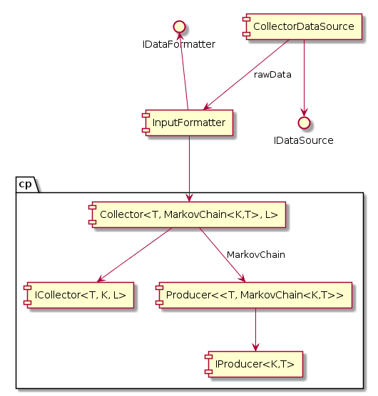
Collector/Producer Components
Collector

Slide 16
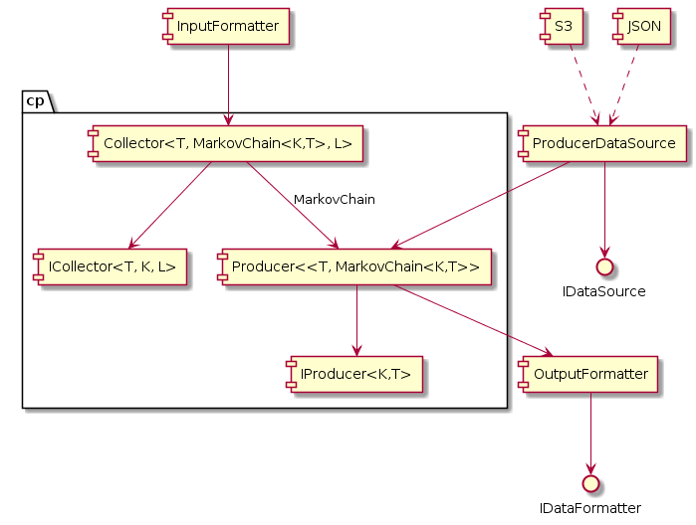
Collector/Producer Components
Producer

Slide 17
Live Demo
WordProducer
test sample data
drug names – order 3
WordCollector
tickets_out.json – 666 records
tickets_sample.json – small sample of 68 records
tickets_out Dev-Review.json – 1000 records
tickets_small_sample.json – order 2, csv output
HarmonyChordCollector
Beatles – order 2
ChordProgressionProducer
Beatles – order 3

Slide 18
Some Problems
Collection Data Preparation
Collector results presentation
Results interpretation
Framework flexibility

Slide 19
Questions?
References
Markov chain Wikipedia Article
GitHub Projects
Math-lib
Music-framework
Text-processing

